Slide 1
Design and Implementation of an Expert Recommendation System for Making Design Decisions
Kevin Koch, Advisor: M.Sc. Manoj Mahabaleshwar, Garching, 11.12.2017

Slide 2
Agenda
1
Introduction
2
Research Questions
3
Methodology - Understanding Design Decisions
4
Approach for Expert Recommendation
5
Timeline
6
Sources

Slide 3
1. Introduction
Example Scenario
Apache Spark
Issues captured since early 2014
Versions from 0.9.0 to 2.1.0
# contributors - 1,146
# issues - 21,660
Users
Create new issue
(incl. design task)
We want to use Spark SQL in our project, but we found that the Spark SQL performance is not very well as we expected.
SPARK-7393
?
Who should be assigned?
Software Architects
Software Developers
Notes:
Example project Open Source now – however not focused on FOSS
(comparison to projects at Siemens where many people from different are involved – large scale projects)
Many contributers, many issues
Users create a new issue/feature request which is identified by a design task (Manoj recent work already make this possible)
Solved by developers or architects…
Question is – who should be assigned???
I want to answer this in my research

Slide 4
1. Introduction
Problem areas
How are design decisions made?
  Individual or Group-Decision Making
  Naturalistic Decision Making, Rational Decision Making or Bounded Rational Decision Making
  Underlying process in context of design?
Who makes design decisions?
  Which people are involved?
  Exist specific roles for decision makers?
How are information accessed?
  Who has expertise in what?
  Is knowledge about possible solutions tacit or explicit?
  …
Notes:
Seeing this simple example, one can have many questions…
Read some of them
This was my starting point in exploring the topic and I found several insights which help me to structure my thesis.

Slide 5
1. Introduction
Design Problems
Design problems are wicked problems [1]
Characteristics [2]:
There is no definitive formulation of a wicked problem
Wicked problems have no stopping rule
Solutions are not true or false, but good or bad
There is no immediate and no ultimate test of a solution to a wicked problem
Every solution to a wicked problem is a “one-shot operation”
Reasoning and final decision must consider various options
Notes:
No definitive formulation: ill defined problem – difficult to fully describe – normally first task
No stopping rule: in exploration, one can sink hundreds of hours
Many solutions may work – but the question is how good?
There is not like in mathematics a test to say the solution is correct
One Shot – After implementation, change limited due to e.g. cost and efforts

Slide 6
1. Introduction
Design Decisions Structure [3] [4]
Software Architecture
(high level)
Software Design
(medium level)
Code, and so on
(low level)
Software architecture and software design decisions are in focus
Notes:
Design decision range: architectural pattern decision (as model view client) over use of specific apis to structure/composition of classes
What stands behind a design decision: rationale, design rules and constraints, maybe additional requirements – may increase wicked problems
High: use of programming languages, architectural pattern styles, maybe decisions under constrains (skill set of employees or contracts (vendor contracts etc.)
Medium: selection of specific framework/libraries, define composition of systems, high impact
Realization/Low: usage of specific APIs, location of responsibilites, low impact
Difference between architecture and design

Slide 7
1. Introduction
Decision Making Process
Rational Decision Making [5]
Naturalistic Decision Making [6]
Identify problem
Experience the situation
All possible
information
included
Generate options
Reject
Select possible solution
Analyze options
e.g. via
utility function
Goals
Expecations
Cues
Past Experience
…
Heuristic (e.g. Story Telling)
Select best option
Accept
Implement decision
Act
Notes:
Present both
Rational decision making – present – that is how we think to decide
From military comes Naturalistic decision making – same for firefighters, high stress situations, high uncertainty, use to find working solutions in a timely manner

Slide 8
1. Introduction
Decision Making Process
Bounded Rational Decision Making [7]
Identify problem
Identify problem
Experience the situation
All possible
information
included
All known
information
included
Generate options
Reject
Generate options
Select possible solution
Analyze options
e.g. via
utility function
Process
available data
in a simplified
way
Goals
Expecations
Cues
Past Experience
…
Use heuristic
Heuristic (e.g. Story Telling)
Select best option
Select satisficing option
Accept
Implement decision
Implement decision
Act
Designers either follow NDM or (B)RDM depending on the context [8]
Notes:
Talk about difference to RDM
For many decisions, designers should at least use Bounded rational decision making, NDM simplifies a lot and later changes are costful
Certain methods can increase reasoning and find better rational – (brainstorming, delphi method, devil‘s advocate…)

Slide 9




1. Introduction
Expertise in Design
Long Experience [9] [10]
High Performance [9]
Threshold
Faster problem
comprehension
Adequate problem
representation
Expertise
Years
Broader
knowledge base
More time on communication
and cooperation
Increased expertise leads to better design solutions [9]
Notes:
What is expertise in design? Increased expertise leads to better solutions…. People assessment
Long experience vs High performers
(still do not forget, difficult to measure… good vs bad, qualitative estimation)
Long experience
expert vs novice – how long is someone in a job, project,…?
Expertise of this person increase, broader knowledge, scanning for inconsistencies, usage of tools,…
However just until a certain threshold
High performers
-> Expertise can be measured in both ways
This is a starting point for expertise – more information necessary

Slide 10





1. Introduction
Global Software Engineering [11]
Worldwide & distributed
“New“ Tools to tackle coordination
Hello!
Hallo!
你好!
…
Changes environment for decisions + need to know who to involve
Notes:
Context/environment
Common problems in worldwide distributed teams:
Cultural differences
Language barriers
Isolation
Missing informal communication
Who knows what?
-> coordination problems
New tools change hereby way of communication and coordination
Discussion on online platforms, task management, work assignment,…
However still limited in huge size projects – possibility to improve
Data is spread over many tools, no single point of truth

Slide 11
1. Introduction
Example Scenario
Apache Spark
Issues captured since early 2014
Versions from 0.9.0 to 2.1.0
# contributors - 1,146
# issues - 21,660
Users
Create new issue
(incl. design task)
We want to use Spark SQL in our project, but we found that the Spark SQL performance is not very well as we expected.
SPARK-7393
?
Who should be assigned?
Software Architects
Software Developers
Notes:
Coming back to our example

Slide 12
1. Introduction
Example Scenario
Apache Spark
Issues captured since early 2014
Versions from 0.9.0 to 2.1.0
# contributors - 1,146
# issues - 21,660
Users
Create new feature request (incl. design task)
We want to use Spark SQL in our project, but we found that the Spark SQL performance is not very well as we expected.
SPARK-7393
Analysis of
existing issues
?
Expertise Identification
Who should be assigned?
?
What kind of expertise is existing?
Architectural Elements
Software Quality Attributes
…
Software Architects
Software Developers

Slide 13
1. Introduction
Example Scenario
Apache Spark
Issues captured since early 2014
Versions from 0.9.0 to 2.1.0
# contributors - 1,146
# issues - 21,660
Users
Create new feature request (incl. design task)
We want to use Spark SQL in our project, but we found that the Spark SQL performance is not very well as we expected.
SPARK-7393
Analysis of
existing issues
?
Expertise Identification
Who should be assigned?
Architectural Elements
?
Software Quality Attributes
…
Are there specific roles with certain responsibilities or influence?
Software Architects
Software Developers
Expertise Profiles / Roles

Slide 14
1. Introduction
Example Scenario
Apache Spark
Issues captured since early 2014
Versions from 0.9.0 to 2.1.0
# contributors - 1,146
# issues - 21,660
Users
Create new feature request (incl. design task)
We want to use Spark SQL in our project, but we found that the Spark SQL performance is not very well as we expected.
SPARK-7393
Analysis of
existing issues
?
How should assignment be done?
?
Expertise Identification
Who should be assigned?
Additional factors as newcomers, workload of experts,…
Architectural Elements
Software Quality Attributes
…
Software Architects
Software Developers
Expertise Profiles / Roles

Slide 15
1. Introduction
Example Scenario
Apache Spark
Issues captured since early 2014
Versions from 0.9.0 to 2.1.0
# contributors - 1,146
# issues - 21,660
Users
Create new feature request (incl. design task)
We want to use Spark SQL in our project, but we found that the Spark SQL performance is not very well as we expected.
SPARK-7393
Analysis of
existing issues
!
Assignment Recommendation
Expertise Identification
Additional factors as newcomers, workload of experts,…
Architectural Elements
Software Quality Attributes
…
Software Architects
Software Developers
Expertise Profiles / Roles

Slide 16
2. Research Questions
How to quantify/measure the expertise of software architects and developers in the context of design decision-making process?
?
What are the separate roles taken during the decision-making process to address design decisions?
?
How to automatically identify experts to address design decisions and allocate roles to the recommended experts?
?

Slide 17
3. Methodology
(Systematic) Literature Review [12]
Approach:
Inspect for previous literature research on design decisions (completed)
Define review protocol (sources, queries, inclusion/exclusion criteria, quality criteria,… ) (completed)
Perform literature review (in progress)
Merge with previous found literature related to topic
Analysis via meta-ethnography
Notes:
Meta-ethnography: method to put single findings together for defining the whole, using single results, but them in a higher process – how do results combine and create a complete view on it
three ways how studies can be related to each other
directly comparable as reciprocal translations
they may stand in opposition to one another as refutational translations
or taken together they may represent a line of argument

Slide 18
3. Methodology
Case Study [13]
Interviews with architects and developers from industry (Siemens) to examine common practice problems
Example Questions:
How do you assign people to design issues and in general?
How are architects engaged in design decisions?
What is your onboarding process for new employees, especially developers and designers/architects?
…
LR + case study = identify requirements for an expert recommender

Slide 19
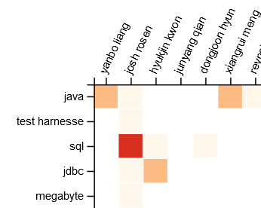


4. Approach for Expert Recommendation
General Overview
1. Expertise Identification
3. Expert Recommendation
Set of ADDs
Set of ADDs
Set of DDs
2. Expertise Representation
Theoretical via LR and Case Study
(for implementation use Manoj’s results [14])
Implementation
(Prototype)

Slide 20
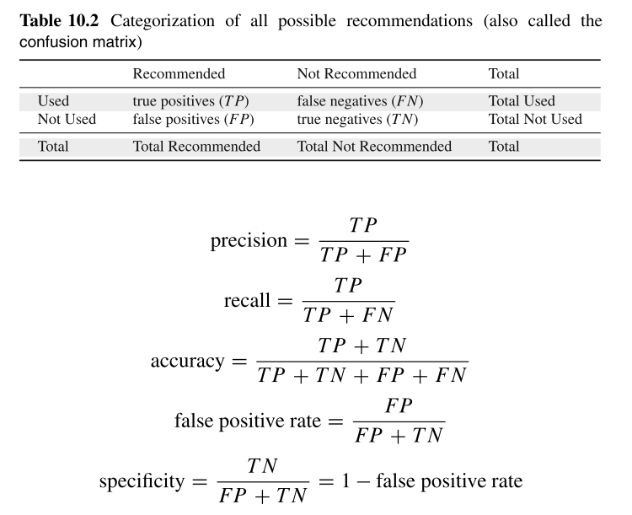
4. Approach for Expert Recommendation
Evaluation
Quantitative Historical Evaluation [15]:
  Correctness via Precision and Recall
  TP = true positive, FP = false positive, FN = false negative
  Compare developed algorithm with other known expert recommender algorithms
Qualitative Evaluation via Case Study:
  Feedback on a Siemens project for proposed solutions
Quantitative and qualitative evaluation ensures triangulation
Notes:
Historical:
Build data matrix until a due date – validate on the next days
Precision: how many of the results are correct results? (e.g. 3 people recommended, two were historically, precision 2/3)
Recall = how many results of all possible correct results are presented?
E.g. we can use clustering, Manoj approach from his paper, other algorithms

Slide 21
5. Timeline
2017
2018
Tasks
  Month
11
12
1
2
3
4
5
Kick-off Presentation
Systematic Literature Review
Case Study
Development
Evaluation
Writing
Final Presentation

Slide 22
6. Sources
[1] Rittel, H. W. (1987). The reasoning of designers. Montreal: IGP.
[2] Rittel, H. W., & Webber, M. M. (1973). Dilemmas in a general theory of planning. Policy sciences, 4(2), 155-169.
[3] Abrahamsson, P., Babar, M. A., & Kruchten, P. (2010). Agility and architecture: Can they coexist?. IEEE Software, 27(2).
[4] Jansen, A., & Bosch, J. (2005). Software architecture as a set of architectural design decisions. WICSA 2005. 5th Working IEEE/IFIP Conference on Software Architecture (S. 109-120). IEEE.
[5] Simon, H. A. (1978). Rationality as process and as product of thought. The American economic review, 1-16.
[6] Zsambok, C. E. and G. A. Klein (1997). Naturalistic decision making, L. Erlbaum Associates.
[7] Simon, Herbert A. "A behavioral model of rational choice." The quarterly journal of economics 69.1 (1955): 99-118.
[8] Zannier, C., Chiasson, M., & Maurer, F. (2007). A model of design decision making based on empirical results of interviews with software designers. Information and Software Technology, 49(6), S. 637-653.
[9] Sonnentag, S., Niessen, C., & Volmer, J. (2006). Expertise in software design.
[10] Zhou, M., & Mockus, A. (2010, November). Developer fluency: Achieving true mastery in software projects. In Proceedings of the eighteenth ACM SIGSOFT international symposium on Foundations of software engineering (pp. 137-146). ACM.

Slide 23
6. Sources
[11] Herbsleb, J. D. (2007, May). Global software engineering: The future of socio-technical coordination. In 2007 Future of Software Engineering (pp. 188-198). IEEE Computer Society.
[12] Keele, S. (2007). Guidelines for performing systematic literature reviews in software engineering. In Technical report, Ver. 2.3 EBSE Technical Report. EBSE. sn.
[13] Runeson, P., & Höst, M. (2009). Guidelines for conducting and reporting case study research in software engineering. Empirical software engineering, 14(2), 131.
[14] Manoj’s Paper work in progress
[15] Avazpour, I., Pitakrat, T., Grunske, L., & Grundy, J. (2014). Dimensions and metrics for evaluating recommendation systems. In M. Robillard, W. Maalej, R. Walker, & T. Zimmermann, Recommendation systems in software engineering (S. 245-273). Heidelberg: Springer.

Slide 24

Questions?

Slide 25
(Systematic) Literature Review (1/2)
Sources:
  Databases
  ACM Digital Library
  Science Direct
  IEEE Xplore
  Conferences
  European Conference on Software Architecture (ECSA)
  International Conference on Software Architecture (ICSA)
  Working IEEE/IFIP Conference on Software Architecture (WICSA)
  International Conference on Design Science Research in Information Systems and Technology
Query:
  TIKEAB:("software design" AND "decision making“ AND expert*) OR TIKEAB:("software design" AND role AND expert*)
Around 1.000 results

Slide 26
(Systematic) Literature Review (2/2)
Inclusion Criteria:
  Any study that quantifies expertise in the context of software development & design
  Any study that inspects roles in the context of software development & design
Exclusion Criteria:
  Any study that does not focus on the development or the process of development of software systems
  Any study that inspected student behavior
  Any study that is not a primary study
  Any study that does not pass the quality criteria
Study Selection Procedures:
  Identify relevant studies from databases and journals
  Exclude studies based on titles
  Exclude studies based on reading the abstract
  Obtain papers
  Final selection based on quality criteria

